Slide 1

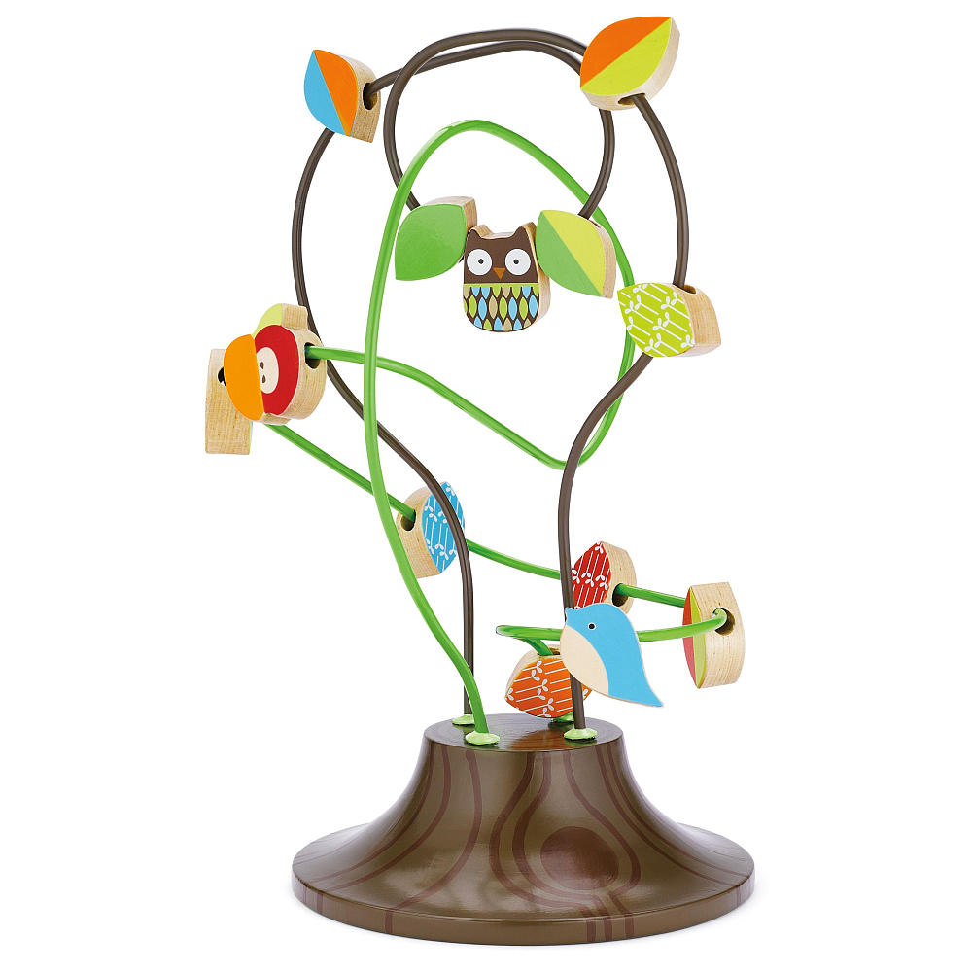
Skip Hop Treetop Friends Busy Bead Tree
Toy Name
Skip Hop Treetop Friends Busy Bead Tree
Manufacturer
Skip Hop
Age
12 – 18 months
Parts
Treetop Friends Busy Bead Tree
Develop Skills
Fine Motor
Cognitive
How it Works
Mainan edukatif yang dinamis ini akan membuat si kecil sibuk! Balik, putar, dan seluncurkan tiap piece untuk mengajarkan anak koordinasi motorik.
-
This dynamic learning toy keeps little ones busy! Flip, spin, and slide the pieces along the branches to teach coordination.
How To Clean
Simply clean using a cloth that has been sprayed with non-toxic anti bacterial solution
Warning
Do not wash/soak in water
Store in a dry place
Keep out of direct sunlight

